Slide 1
Moody with RPart
Rushabh Jhaveri
RUID: 171008850

Slide 2

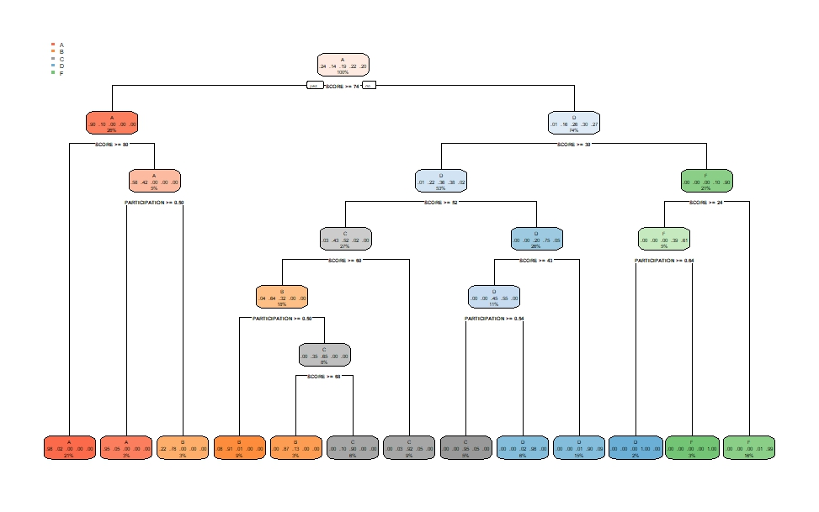
Using RPart
Using rpart, we build the tree.
This tree gives us a good idea of what rules to follow to predict the grades.

Slide 3
The Rules
Using the tree generated by rpart, we were able to determine the rules that govern the allotment of grades.
Example:
decision[myprediction$SCORE<51 & myprediction$SCORE>43 & myprediction$PARTICIPATION > 0.5] <- 'C'
decision[myprediction$SCORE>59 & myprediction$SCORE<67 & myprediction$PARTICIPATION < 0.5] <- 'C'
decision[myprediction$SCORE<29 & myprediction$SCORE>24 & myprediction$PARTICIPATION > 0.6] <- 'D'
decision[myprediction$SCORE<80 & myprediction$SCORE>73.8 & myprediction$PARTICIPATION < 0.5] <- 'B'

Slide 4
Result
Using rpart, on the training data, Kaggle gave me a accuracy of ~87%.
This is good, but it can definitely be improved upon.
The usage of rpart and decision trees drastically improved my prediction accuracy from the previous prediction challenge (75% to 87%).

